Slide 1

CEO of Territory.
Name:
Date:

Slide 2
Summary.

Slide 3
my territory overview.
FY25 Target £
FY24 Target £
FY24 Achievement £
= x % of quota
FY25 Opening Pipeline £
= x % of cover
I will exit H1 £
= x % of quota
I have been at (Company) for X years
In this position for X years
LinkedIn SSI Score:
Av FY24 monthly RR was £
Expected FY25 monthly RR £
% of quota made up of RR deals %
I have:
X Tier 1 accounts
X Tier 2 accounts
X Tier 3 accounts
My Key deals for Q1 are:
X
X
X
X
My Key deals for Q2 are:
X
X
X
X
Best achievements FY24
X
X
X
X
What's working:
X
X
X
X
What’s not working:
X
X
X
X
Worst moments FY24
X
X
X
X

Slide 4
🚀 VSEM - Vision Strategy Execution Metrics
Vision
Strategy 1.
Strategy 2.
Strategy 5.
Strategy 4.
Strategy 3.
Execution
*
*
*
*
Execution
*
*
*
*
Execution
*
*
*
*
Execution
Execution
*
*
*
*
*
*
*
*
Metrics:

Slide 5

ASPIRATIONAL GOALS
key FY25 commitments.
1️⃣ Complete….
2️⃣ Complete….
3️⃣ Complete….
4️⃣ Complete….
5️⃣ Complete….
Ensure these are SMART commitments

Slide 6
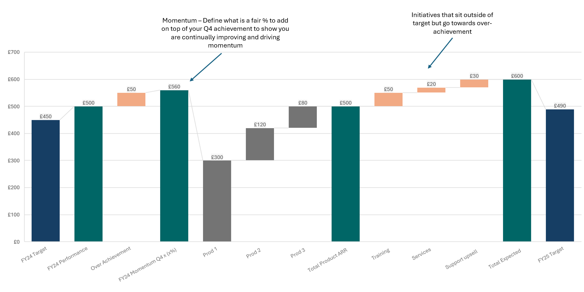
COMMUNICATE DATA EFFECTIVELY
personal bridge to FY25 quota.

Slide 7
Key Deals.

Slide 8
SETTING OUT THE BIG BETS
H1 key deals.
Prospect | Where are we in the sales process? | Engagement (what level are we at?) | Next steps | Competition | Close date | Value | % Win confidence
 |  |  |  |  |  | £
 |  |  |  |  |  | £
 |  |  |  |  |  | £
 |  |  |  |  |  | £
 |  |  |  |  |  | £
 |  |  |  |  |  | £
 |  |  |  |  |  | £
 |  |  |  |  |  | £

Slide 9
SETTING OUT THE BIG BETS
H2 key deals.
Prospect | Where are we in the sales process? | Engagement (what level are we at?) | Next steps | Competition | Close date | Value | % Win confidence
 |  |  |  |  |  | £
 |  |  |  |  |  | £
 |  |  |  |  |  | £
 |  |  |  |  |  | £
 |  |  |  |  |  | £
 |  |  |  |  |  | £
 |  |  |  |  |  | £
 |  |  |  |  |  | £

Slide 10
CAN WE MAKE A FAST START TO THE YEAR
Q1 metrics.
70%
80%
6:1
£25.4k
Q1 Pipeline Cover 3:1
Q1 Commit Against Target
Current Sales Conversion
Average Order Value
Not yet found
Q1 Pipeline
Yet to commit
Q1 Commit
Target 3:1
Current Conversion 6:1
Target AOV £35.6k
Current AOV
Develop metrics that work for your business

Slide 11

IDENTIFY REVENUE CHALLENGES EARLY
gap strategies.
Detail activities you will undertake to close the gap if you have one.
1️⃣ Complete….
2️⃣ Complete….
3️⃣ Complete….
4️⃣ Complete….
5️⃣ Complete….

Slide 12
SWOT.

Slide 13

S
STRENGTH ANALYSIS:
Describe your overall strengths in hitting your quota and your plan being successful.
👉…
   

Slide 14

WEAKNESS ANALYSIS:
Highlight where you plan is weak or where more detail or research is required.
👉…
w
   

Slide 15

O
OPPORUNITIES ANALYSIS:
Describe opportunities, these could be market segments or geographical areas you think could be perfect for development.
👉…
   

Slide 16

THREATS ANALYSIS:
Detail what could go wrong or what could hold back your plan, make sure you have thought about what you can do to mitigate these threats.
👉…
T
   

Slide 17
Business Development.

Slide 18
WHERE WILL YOU DEALS COME FROM?
demand generation strategy.
Self-Gen Campaigns
BD & Marketing
Content
Thought Leadership
How do I drive my own leads?
Activities I’m working on with BD & Marketing.
What content will drive positive engagement
What webinars, workshops and events will I plan?




1️⃣ Complete….
2️⃣ Complete….
3️⃣ Complete….
4️⃣ Complete…
.
5️⃣ Complete….
1️⃣ Complete….
2️⃣ Complete….
3️⃣ Complete….
4️⃣ Complete…
.
5️⃣ Complete….
1️⃣ Complete….
2️⃣ Complete….
3️⃣ Complete….
4️⃣ Complete…
.
5️⃣ Complete….
1️⃣ Complete….
2️⃣ Complete….
3️⃣ Complete….
4️⃣ Complete…
.
5️⃣ Complete….

Slide 19
BE CLEAR ON WHO YOU WILL SELL TO
ideal customer profile (ICP).
Explain who is your ICP. Detail their pain points and how your product/solution overcomes them. What is the typical RIO and the value you bring.
1️⃣ Complete….
2️⃣ Complete….
3️⃣ Complete….
4️⃣ Complete…
.
5️⃣ Complete….

Slide 20
Capabilities & Assistance.

Slide 21
DOCUMENT YOUR CUURENT SALES CAPABILITIES
my capabilities.
   
➡️ Sales training completed in last 6 months?
👉…
➡️ Do you have a personal story? (why I’m working for X and my personal USP’s)
👉…
➡️ What are you able to whiteboard? (GTM, Value Proposition etc)
👉…
➡️ What is your ability to talk about the product/solution?
👉…
➡️ Can you answer the question – Why should you buy from X?
👉…

Slide 22
WHAT SUPPORT DO YOU REQUIRE TO BE SUCCESSFUL?
assistance.
   
➡️ What extra support do you require?
👉…
➡️ What sales competencies would you like more coaching on?
👉…
➡️ If you were the Chief Revenue Officer, what would you do to grow the company?
👉…
➡️ What could we do better as a team?
👉…
➡️ What other help do you need from outside Sales to make you successful?

Slide 23

questions.

